Slide 1

RalphiIA
AI-native operating system for founder-led technical companies
Compressing fragmented founder workflows into structured, measurable AI-powered operations.
Pre-seed raise
US$250K to productize RalphiIA, validate operational savings, reduce founder dependency inside PC Doctor, and build a structured San Francisco market-development presence.
InnerChispa LLC · Investor Deck · July 2026
InnerChispa LLC · RalphiIA · Confidential pre-seed deck
1

Slide 2
Company snapshot
Who we are, what we do, where we are now, and what this round unlocks.
Company
Product
InnerChispa LLC, a U.S.-registered technology company building RalphiIA.
An AI-native operating layer connecting agents, workflows, memory, business data and hybrid infrastructure.
Origin
Stage
Born from the real bottlenecks of PC Doctor, a founder-led technical services business.
Operational MVP / internal live beta with active workflows and a live internal ecosystem.
Initial Market
Raise
Founder-led technical companies, MSPs, integrators and operations-heavy SMEs.
US$250K pre-seed for 15–18 months of productization, validation, hiring and market development.
One-line thesis: RalphiIA is turning internal operational compression into a repeatable B2B operating platform.
InnerChispa LLC · RalphiIA · Confidential pre-seed deck
2

Slide 3
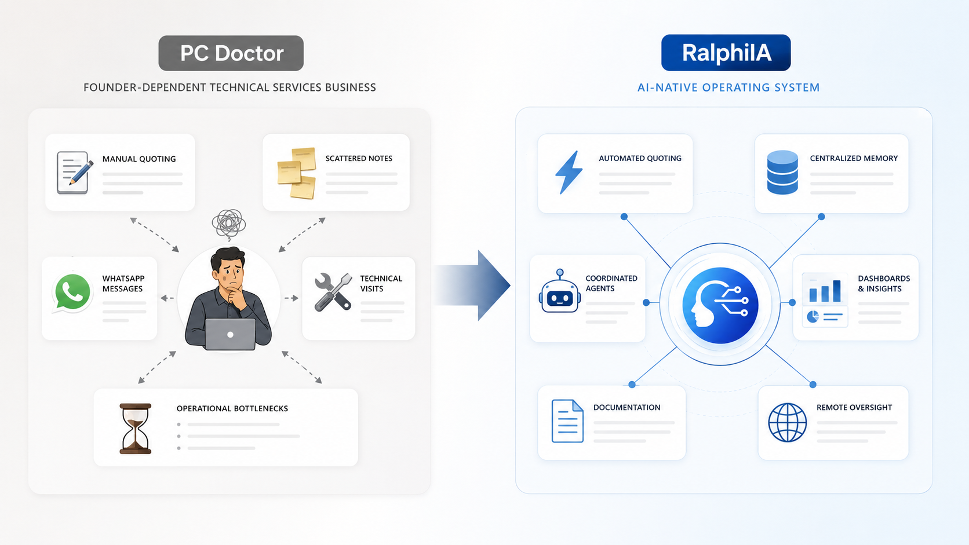
From operational pain to product
PC Doctor is the origin, laboratory and first case-study environment for RalphiIA.
PC Doctor generated the cash flow, customer context and operational friction that made RalphiIA necessary.
The founder lived the problem directly: manual quoting, fragmented notes, constant WhatsApp coordination, technical follow-up and heavy dependence on one person.
RalphiIA emerged as the internal answer: centralized context, coordinated agents, structured proposals, documentation and remote oversight.
The next step is not to abandon PC Doctor, but to transform it into the first measurable before-and-after proof for customers and investors.
“I did not build software and then search for a problem. I lived the problem, built the system I needed, and now I am productizing it.”
InnerChispa LLC · RalphiIA · Confidential pre-seed deck
3

Slide 4
Founder-led businesses do not scale cleanly
The business can generate revenue while its operating knowledge remains trapped inside the founder.
Founder bottleneck
Fragmented context
Slow retrieval
Critical decisions, customer responses and quality control depend on one person.
WhatsApp, email, notes, quotes and project history live across disconnected tools.
Before acting, the team must reconstruct what happened, what was promised and what comes next.
Manual documentation
Weak delegation
Low continuity
Proposals, reports, summaries and follow-up absorb hours of founder time.
New people cannot move quickly because the operating knowledge is not structured.
When the founder travels or gets overloaded, speed and quality drop.
Revenue grows → complexity grows → founder dependency grows
InnerChispa LLC · RalphiIA · Confidential pre-seed deck
4

Slide 5
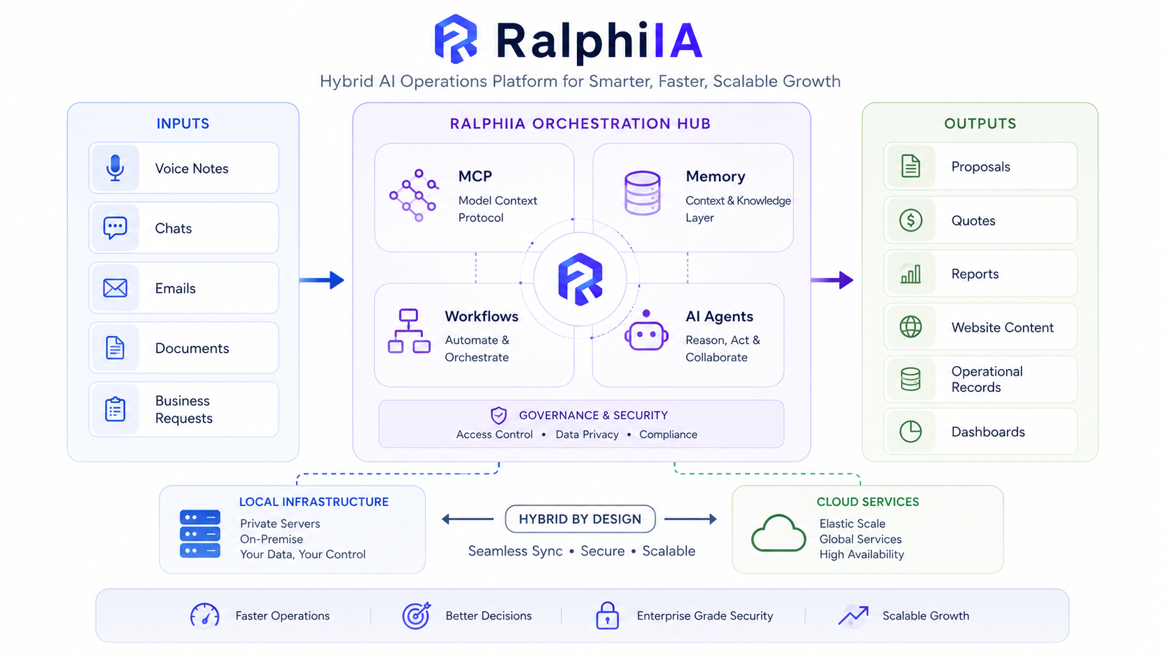
RalphiIA turns fragmented work into coordinated operations
One operating layer that converts business inputs into structured, auditable outputs.
One operating layer. Multiple models, tools and workflows. One business context. Human approval remains in the loop for pricing, commitments and sensitive actions.
InnerChispa LLC · RalphiIA · Confidential pre-seed deck
5

Slide 6
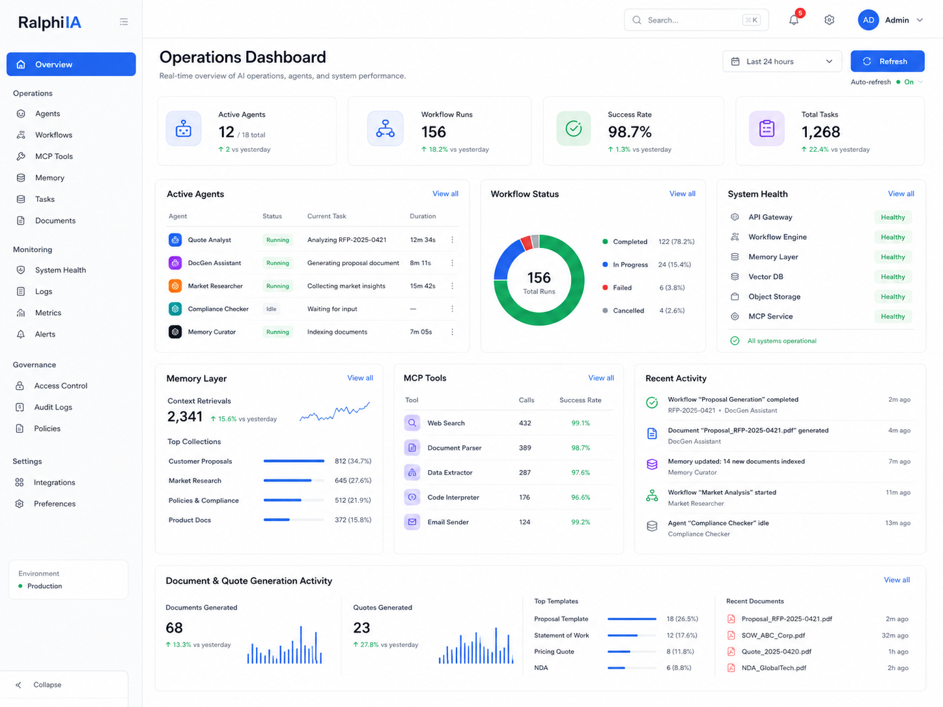
A working AI operations stack, not just a concept
What exists today inside the product and why it matters.
Business interfaces: web panels, internal dashboards, chat inputs, documents and developer tools.
Orchestration layer: MCP connectivity, AI agents, workflow routing, approval gates and audit trails.
Memory and context: Mongo-based operational memory, project records and synchronized knowledge sources.
Execution infrastructure: local Linux servers, cloud services, staging/production separation and remote development.
Human governance: final approvals, permissions, validation and rollback for sensitive actions.
The system is designed to act, remember, coordinate and remain auditable.
InnerChispa LLC · RalphiIA · Confidential pre-seed deck
6

Slide 7
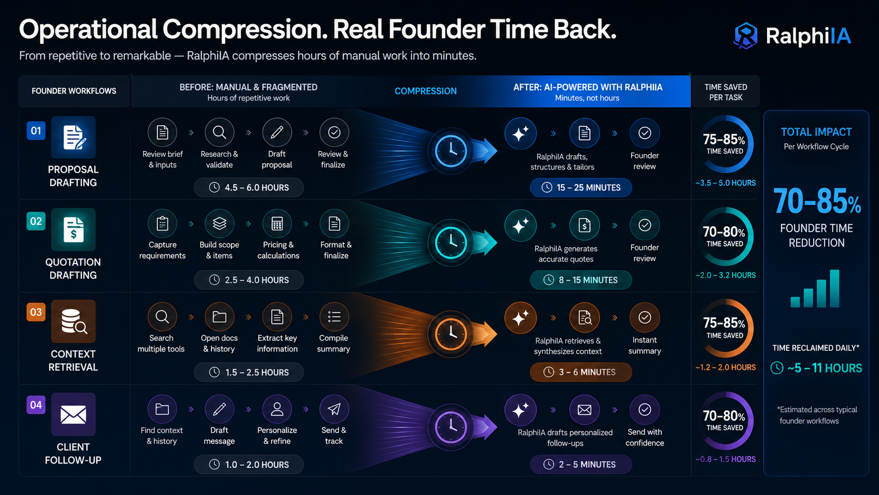
Operational compression: from hours to minutes
The core thesis is founder time back — not just faster writing, but a shorter entire operating chain.
Proposal drafting
Quotation drafting
4.5–6h → 15–25m
2.5–4h → 8–15m
≈75–85% reduction
≈70–80% reduction
Context retrieval
Client follow-up
1.5–2.5h → 3–6m
1–2h → 2–5m
≈75–85% reduction
≈70–80% reduction
Project documentation
2–6h → 15–45m
≈65–90% reduction
Headline KPI
RalphiIA targets a 70–85% reduction in founder time across repetitive, high-friction workflows.
These figures combine current internal benchmarks, modeled manual baselines and active or near-complete automated flows.
InnerChispa LLC · RalphiIA · Confidential pre-seed deck
7

Slide 8
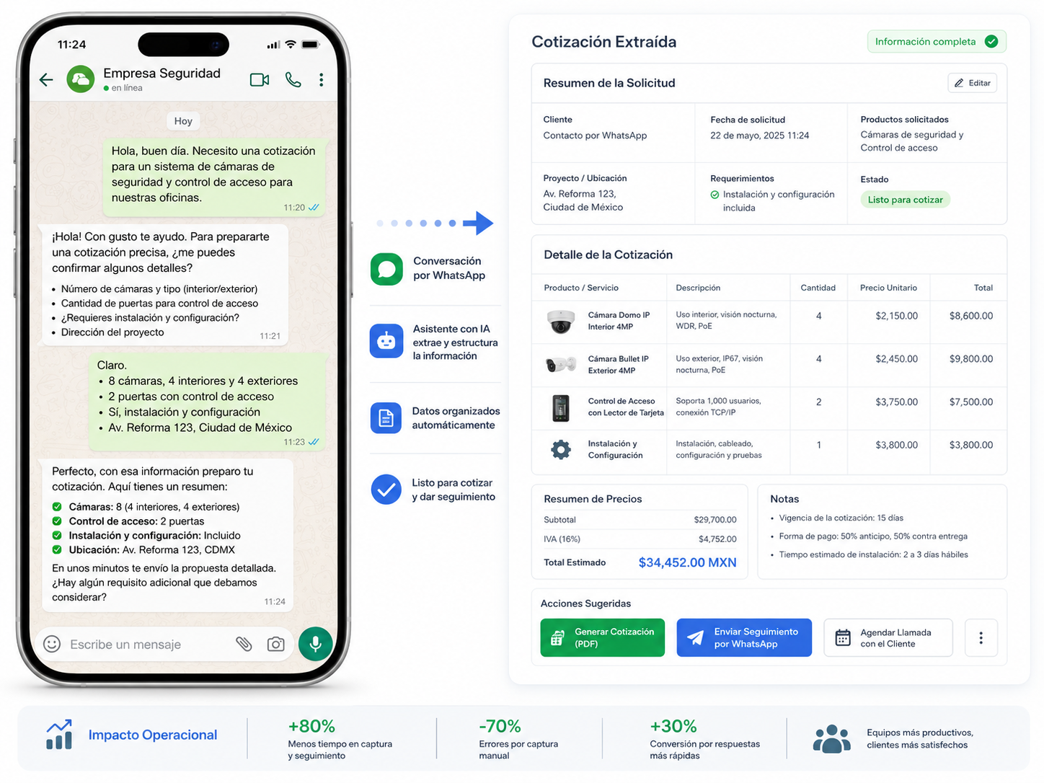
From modeled savings to verified operational evidence
The product is being built to measure the same operations it automates.
How we calculate value
Manual baseline: time searching for context, drafting, reviewing, documenting and following up.
Automated run: time from input to structured output with human approval logged.
Validation: timestamps, repeated runs, workflow logs, error rate and rework.
Evidence levels
Modeled = prior manual process vs current flow design · Observed = seen in real use · Measured = logged with timestamps · Validated = repeated performance with consistent results
Best sentence to use
“Our current internal benchmarks indicate that RalphiIA can reduce 70–85% of founder time in repetitive drafting, context recovery and follow-up workflows, with several flows already active and others reaching final validation.”
InnerChispa LLC · RalphiIA · Confidential pre-seed deck
8

Slide 9
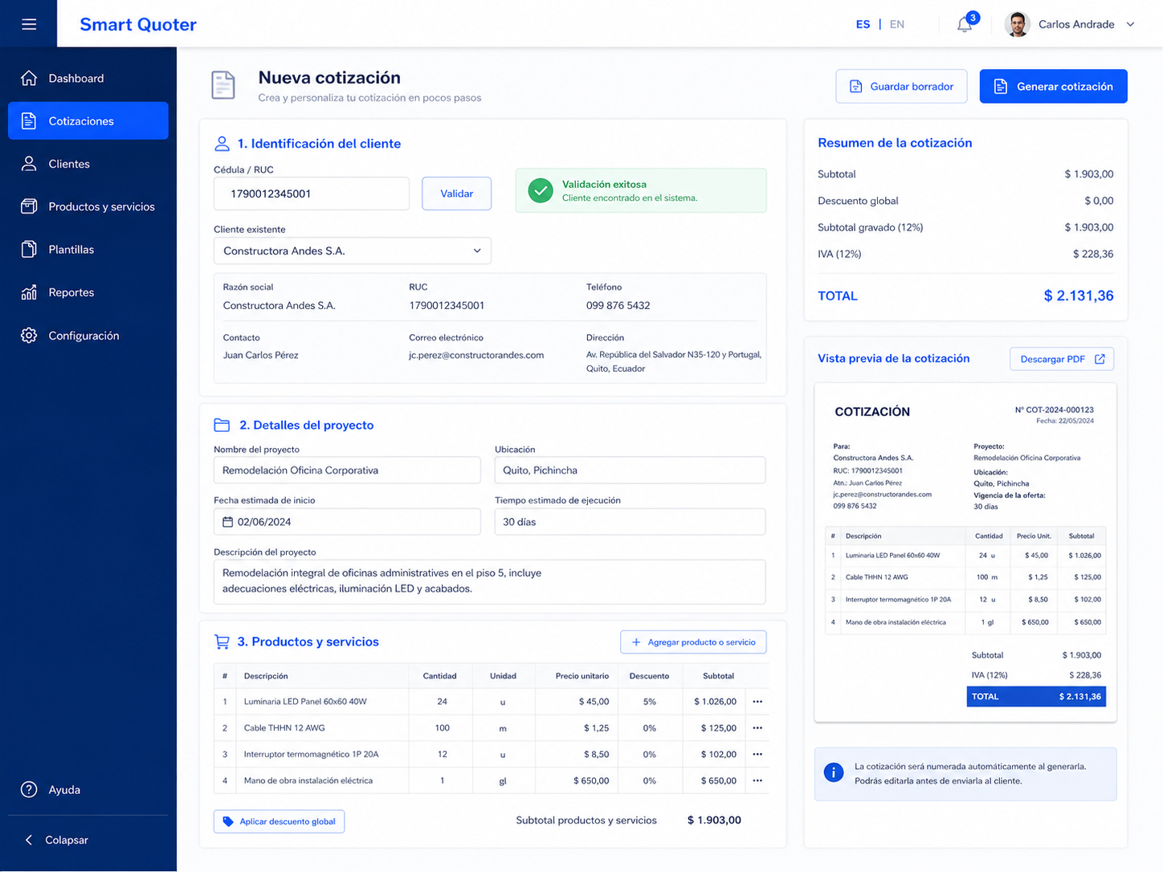
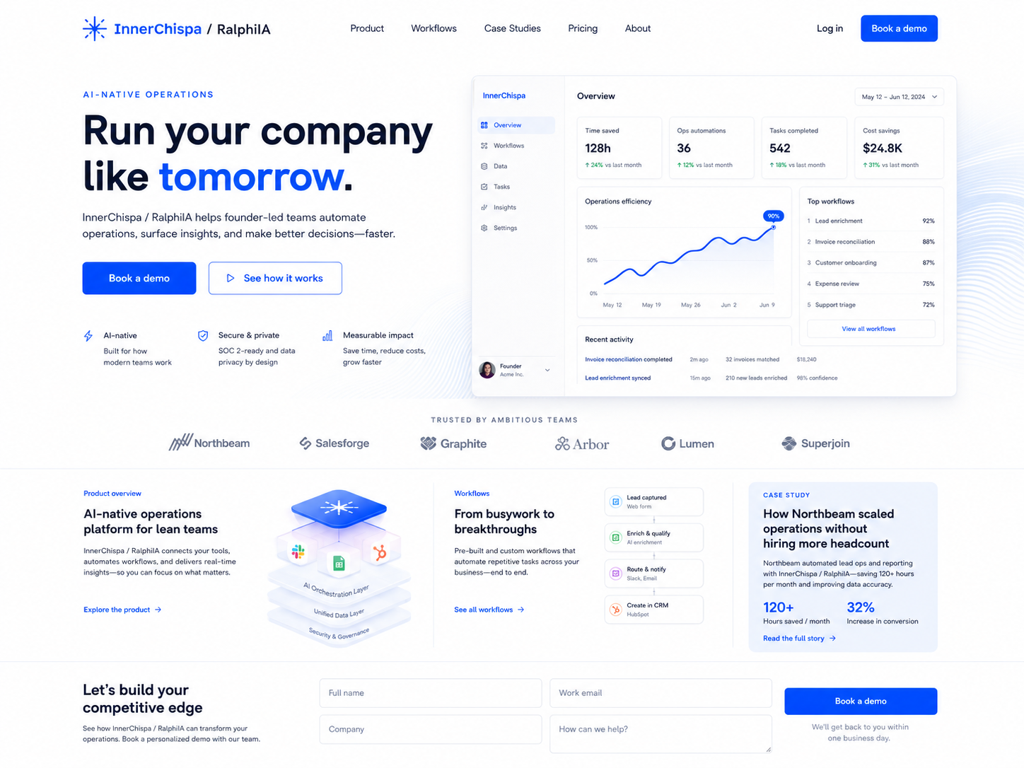
Built, connected and already in use
This is not an idea-stage concept deck — the internal ecosystem is alive and supporting real work.
Smart Quoter
RalphiIA operations dashboard
Web presence / product story
Quote creation, customer identification, project detail capture and proposal preview.
Agents, workflow runs, memory activity, MCP tools and system health in one control plane.
Corporate narrative, product overview, workflows, case-study framing and investor-facing story.
Active today: hybrid infrastructure · MCP tool ecosystem · Mongo-based memory · internal workflows · website staging under development · hackathon-driven iteration.
InnerChispa LLC · RalphiIA · Confidential pre-seed deck
9

Slide 10
Start with one painful workflow. Expand into the operating system.
Go-to-market and business model.
Beachhead market
Land and expand
Revenue model
Founder-led technical service businesses, MSPs, integrators and operations-heavy SMEs.
Initial pains: quotations, context retrieval, follow-up and documentation.
Start with one workflow.
Prove time savings.
Expand into more workflows, dashboards, memory and agents.
Pilot / implementation fee
Monthly platform + support
Expansion through added workflows and higher-value packages
Workflow entry point
Operational expansion
Operating intelligence layer
Quote generation
Follow-up · Documentation · Memory · Dashboards
Agents · Integrations · Oversight · Recurring value
↓ proves value
↓ becomes platform
InnerChispa LLC · RalphiIA · Confidential pre-seed deck
10

Slide 11
PC Doctor: the first live transformation case
A real revenue-generating business where RalphiIA can prove lower founder dependency and faster execution.
Before RalphiIA
Founder handles quoting, fragmented customer history, manual follow-up, inconsistent documentation and limited remote supervision.
With RalphiIA
Centralized operational memory, AI-assisted quote generation, structured follow-up, better documentation, agent coordination and audit trail.
Measured outcomes to track
Time to first draft · time to approved quote · follow-up latency · founder hours saved · documentation completeness · rework rate
Business impact
More delegable operations, faster customer response, lower information loss and better continuity while the founder focuses on RalphiIA.
InnerChispa LLC · RalphiIA · Confidential pre-seed deck
11

Slide 12
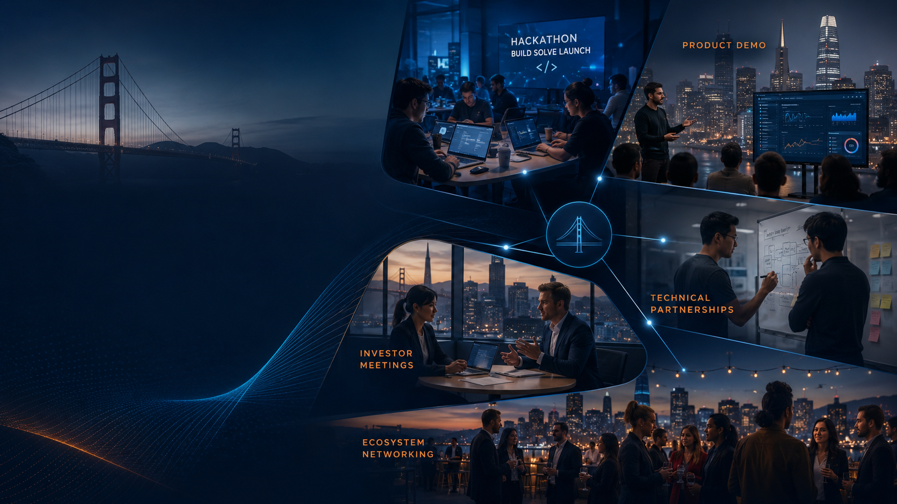
San Francisco as a market-development engine
Not travel for its own sake — faster validation, stronger relationships and better access to capital and partnerships.
Why it matters
Bay Area presence supports hackathons, product demos, investor conversations, customer discovery and strategic technical partnerships.
What it accelerates
Faster product feedback, stronger founder network, higher-quality intros, richer startup visibility and tighter learning loops.
How to frame it
“A structured, milestone-driven market-development presence in the Bay Area tied to demos, partnerships, investor meetings and measurable outcomes.”
Hackathons → Demos → Partnerships → Investor Meetings
InnerChispa LLC · RalphiIA · Confidential pre-seed deck
12

Slide 13
US$250K pre-seed to productize, validate and scale
This round funds the transition from an internal operating system to a repeatable commercial product.
Product & infrastructure · US$65K
Hiring & execution support · US$60K
Platform development, core systems, hybrid infrastructure, evidence capture and stability.
Operational support, implementation capacity, contractors and practical delivery bandwidth.
PC Doctor delegation · US$30K
U.S. market development · US$35K
Reduce founder dependency, document procedures and make the business more remote-manageable.
San Francisco presence, hackathons, demos, meetings and ecosystem access.
Sales & growth · US$20K
Legal / cloud / reserve · US$40K
Website, materials, outreach, design-partner acquisition and early sales experiments.
Legal, accounting, cloud services, APIs, compliance and contingency.
This capital buys time, execution capacity, evidence, commercial packaging and a milestone-driven U.S. market-development strategy.
InnerChispa LLC · RalphiIA · Confidential pre-seed deck
13

Slide 14
12–18 months from internal platform to commercial validation
The roadmap is designed to replace assumptions with evidence at every stage.
0–3 months
3–6 months
6–12 months
12–18 months
Stabilize and instrument
Validate and package
Sell and expand
Prove repeatability
Finalize highest-value workflows
Add KPI logging and timestamps
Improve MCP and agent reliability
Finish stronger web story and demos
Run repeated internal tests
Turn modeled KPIs into measured evidence
Sign initial design partners
Define pilot pricing and onboarding
Launch paid pilots
Expand from one workflow into several
Increase Bay Area demos and meetings
Reduce founder dependency in PC Doctor
Validate multiple customer use cases
Strengthen recurring-revenue signal
Standardize onboarding and integrations
Prepare for follow-on raise or expansion
InnerChispa LLC · RalphiIA · Confidential pre-seed deck
14

Slide 15

Built by an operator, proven in a real business
Why this team can win, and how to reach us.
Founder-market fit
Contact
Scan to visit website
Hands-on experience across infrastructure, automation, customer operations and AI workflows. Built the system from real pain, not theory.
Rafael López
Founder · InnerChispa LLC · RalphiIA
Email
rlopez@innerchispa.us
AI-augmented execution
LinkedIn
Multiple AI tools and agents coordinated across real work. Fast iteration. Lower early-stage execution cost. Parallel progress across product, web and operations.
linkedin.com/in/hlopezgye
Website
www.innerchispa.us
Primary QR destination:
https://www.innerchispa.us
Live validation environment
We are raising US$250K in pre-seed capital and seeking strategic relationships to turn an internal operating system into a repeatable B2B product.
PC Doctor provides real workflows, real pressure, internal automation testing and the first measurable transformation case.
RalphiIA is early, but it is already real: real infrastructure, real operational pain, real workflows and a real path to measurable value.
InnerChispa LLC · RalphiIA · Confidential pre-seed deck
15

